Slide 1
NYC Short-Term Rental Insights Report
Submitted by: Agbataekwe Chuks Chukwunonso
Submitted to: Masterschool
Date: 19-06-2023

Slide 2
Introduction
This project analysis is to analyze the New York City short-term rental insights, some data was given with three different tables which are Prices, Reviews and room types. This analysis will help Pillow Palooza to know the most profitable areas and properties to invest in.
The project will be divided into three parts:
Data Wrangling and Cleaning
Data Analysis and Insights Generation
Presenting your findings for Business Impact

Slide 3
Data Wrangling and Cleaning
The data which was a raw data was cleaned with the help of a google spreadsheet. The following steps where taken:
Data Collection, Data Inspection, Data Cleaning, Data Transformation, Data Integration, Data Formatting, Data Validation and Documentation

Slide 4
Data Analysis and Insights Generation
The tool that was used here was the Structured Query Language (SQL), where the three tables which are the prices, reviews and room types table were being analysed based on the question of the sprints.

Slide 5
Presenting your findings for Business Impact
In this stage, tableau public was used to analyze and present my business questions. These questions were based on some questions which are:
Most popular Neighborhood for short-term rental in New York City.
Most commonly rented property types of Airbnb in New York City.
Top 5 average rental prices in New York City Neighborhood.

Slide 6
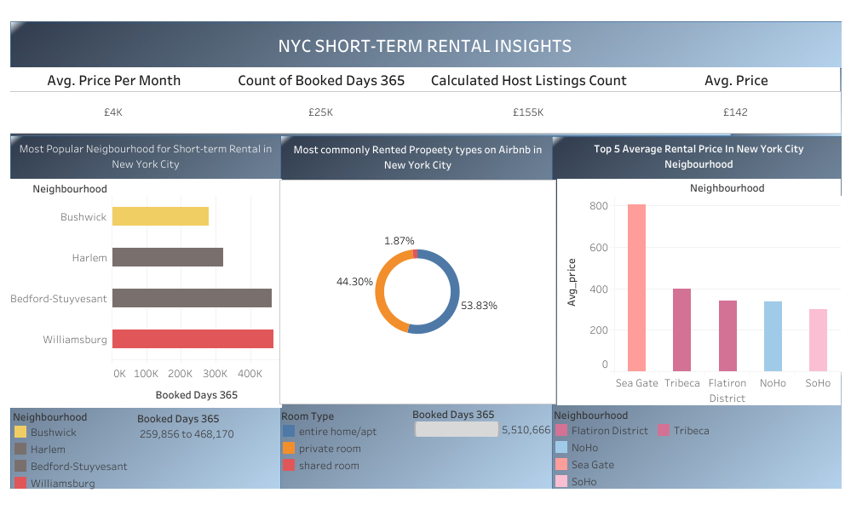
Results
KPI Dashboard

Slide 7
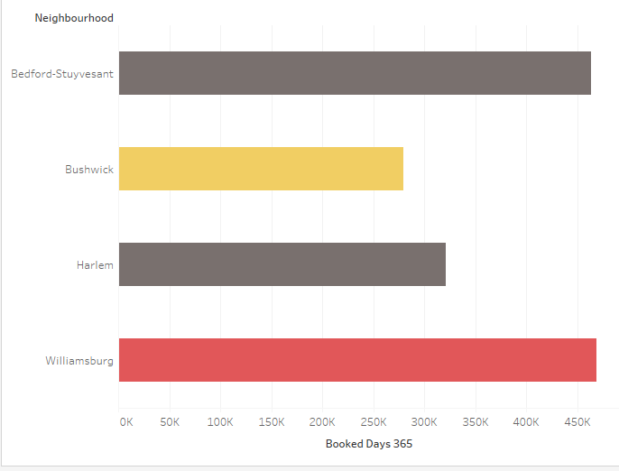
Most popular Neighborhood for short-term rental in New York City.

Slide 8
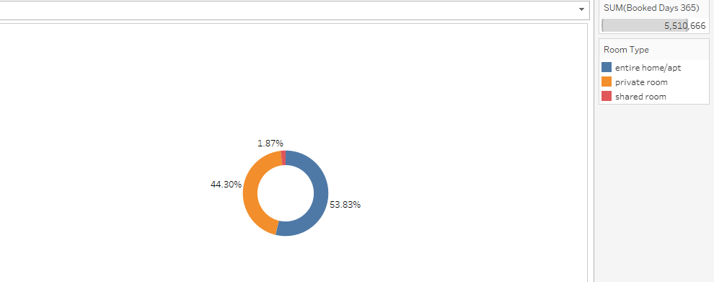
Most commonly rented property types of Airbnb in New York City.

Slide 9
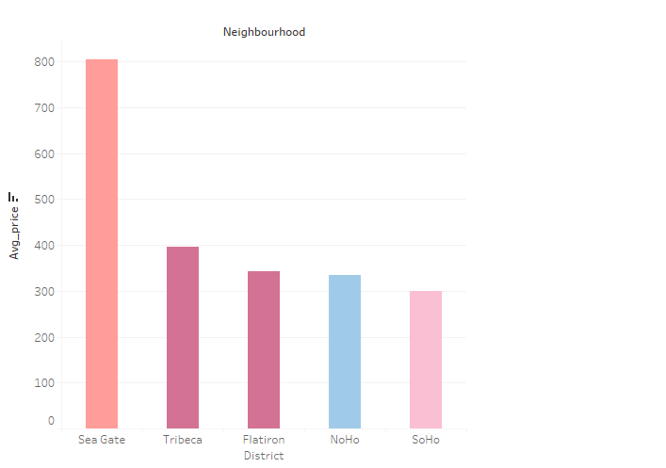
Top 5 average rental prices in New York City Neighborhood

Slide 10
Discussion
From the KPI dashboard above
The average price per month was at £4k, the count on booked days was £25k, the calculated host listing counts is at £155k and the average price was at £142.
Williamsburg is the most popular neighborhood in New York City with 498,170 bookings per year.
Entire home/apt is the most commonly rented property type on Airbnb New York City with 53.83% , followed by private room and shared room with 44.30 and 1.87% respectively.
The top 5 averagely rented prices in NYC Neighborhood are Sea gate, Tribeca, Flatiron, NoHo, SoHo

Slide 11
Recommendation And Conclusion
In recommendation to Pillow Palooza, this points should be put into consideration
Williamsburg should be considered as a better neighbourhood to start-up an Airbnb short-term rental, this is because it has the highest amount of booking per year in New York City. It should also be rented on an average price of £142 to be affordable for customers.
Entire home/apartment and private rooms should be the properties to be invested in, this is because people in the New York neighbourhood prefer to rent such properties than the share room apartment.
In conclusion, from the SQL analysis and tableau presentation, it shows how important and profitable the New York Airbnb investment is, and Williamsburg is a suitable neighbourhood for pillow palooza to invest in, this is with the aid of properties such as entire home/apartment and private rooms.

